Slide 1
Mulesoft Developer POC Presentation
Introduction Mule ESB
Authors: Shrikant Ghuge
Date: 17/04/2018 Version: 1.0

Slide 2
Agenda
Why ESB ..?
Why Mule ESB ..?
POC Project presentation
Deployment options
Community edition limitation
Overall possibilities with Mulesoft

Slide 3
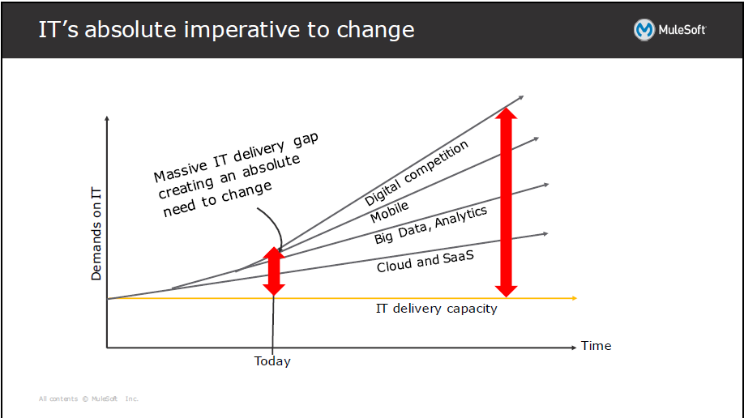
WHY ESB
Increasing organizational agility by reducing time to market for new initiatives is one of the most common reasons that companies implement an ESB as the backbone of their IT infrastructure.

Slide 4
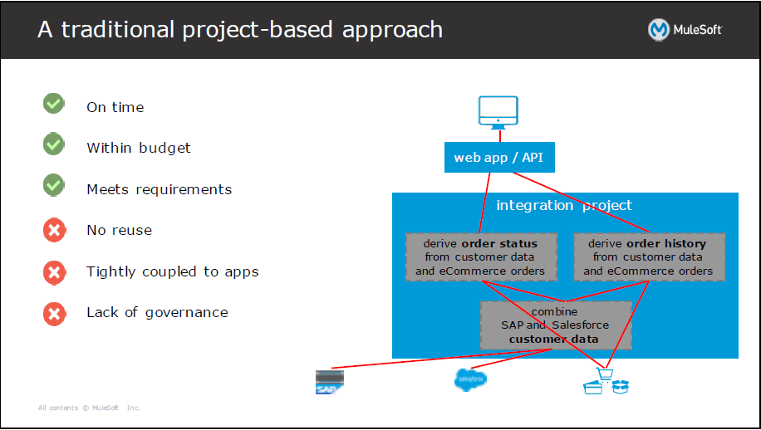
WHY ESB … (Example)

Slide 5
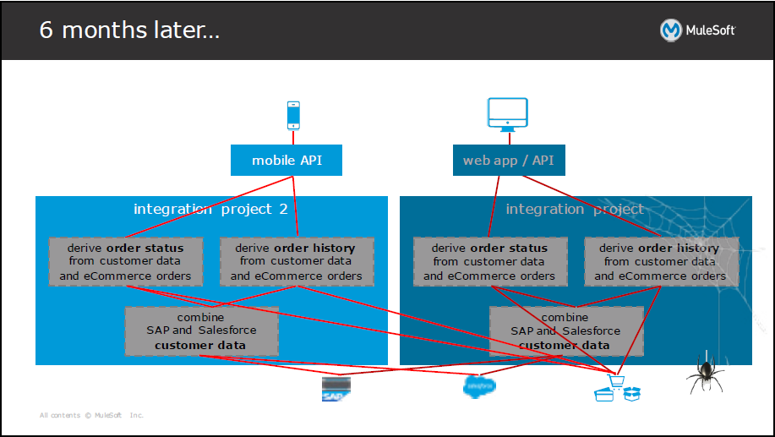
WHY ESB … (Example)

Slide 6
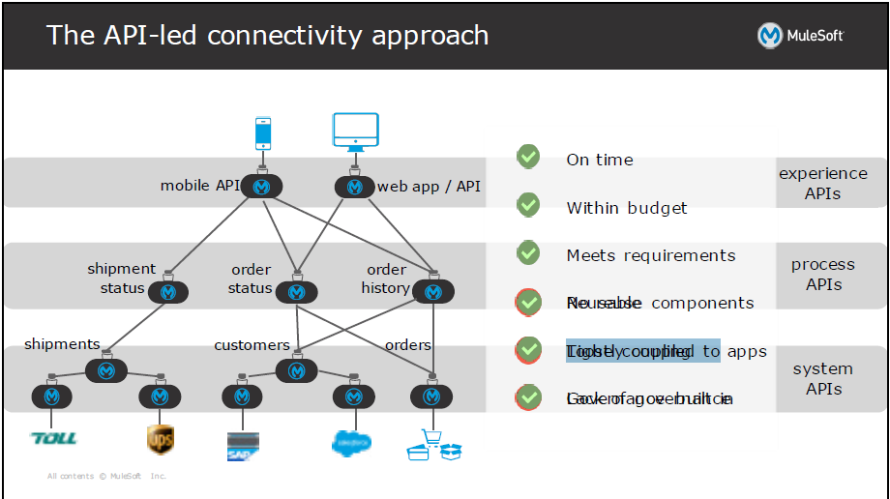
WHY ESB … (Example)

Slide 7
Why Mule ESB ..?
Few out of the box service:
API Designer
API Manager
Anypoint Studio
API Portal
API Analytics
CloudHub
Mule Exchange
Design First with RAML

Slide 8
Why Mule ESB ..?
Out-of-the-box Features :
Message Sources – endpoints - HTTP, FTP, TCP, UDP, File, Database…
Message Processors -Components – REST, SOAP, JavaScript, Java, Python…
Filters
Routers – aggregators, splitters, round-robin…
Scopes – Flows, sub-flows, for-each, a-synchronous…
Transformers –
Built-in transformers - convert XML, JSON, File, Byte Array, Object, String...
Dynamic transformer – Anypoint DataMapper dynamically converts between flat (CSV, fixed-width file, Excel) and structured (XML, JSON, POJO objects, key-value maps) formats.
Connectors – Mulesoft has numerous connectors to third-party commonly used applications – Amazon, Facebook, Google products, Sharepoint, MongoDB, Salesforce and Twitter to name a few.
Opensource : You can extend the existing feature, connectors easily

Slide 9
POC Project presentation
To implement current POC in Java or Python We will need :
Library to call a web service efficiently.
external Library to create csv file dynamically.
Library to connect SFTP and push the file to SFTP client.
Things to consider …
Time : Development / Maintenance
Visualization
Runtime monitoring
Proxy/ SLA/ Rate limit/ Authentication

Slide 10
POC Project presentation
With Mule
It takes less than hour for development and less than 5 hours to deploy the application to CloudHub.
A non technical person also visualize what is happening.
No external library used.
API proxy, SLA and auth schemas are already supported on Mule API manager.
DEMO of current POC

Slide 11
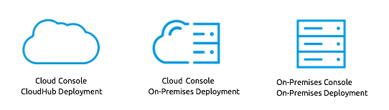
Deployment options
A Runtime option
On Prem
Cloud

Slide 12
Deployment options …
Deployment Ways
With maven : license required
Create package and upload to mule runtime (Cloud)
Anypoint studio has the option
Without maven : no license required
Export as Deployable archive and upload to runtime
Anypoint has option to deploy directly
Note : If org has DevOps setup, It is recommended to use DevOps.

Slide 13
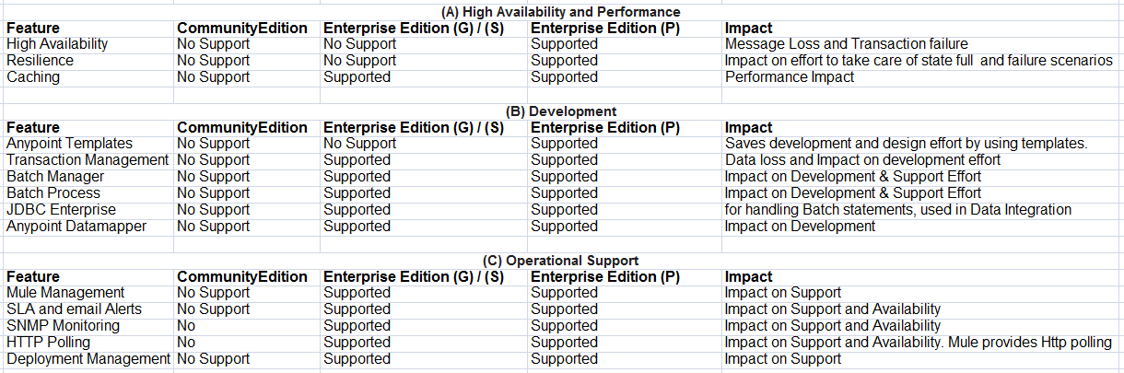
Community edition limitation

Slide 14
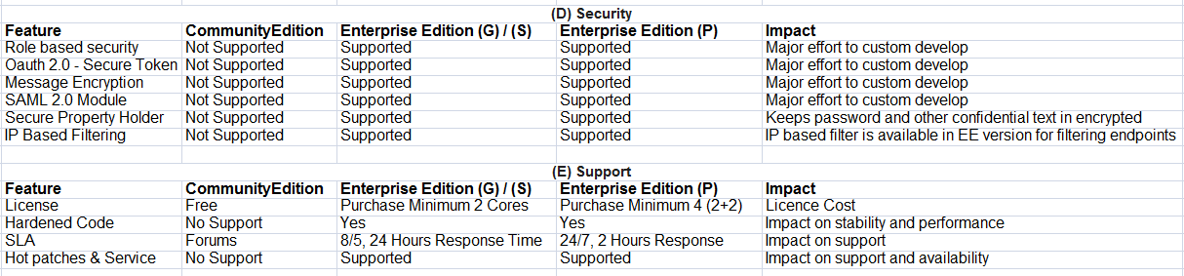
Community edition limitation …

Slide 15
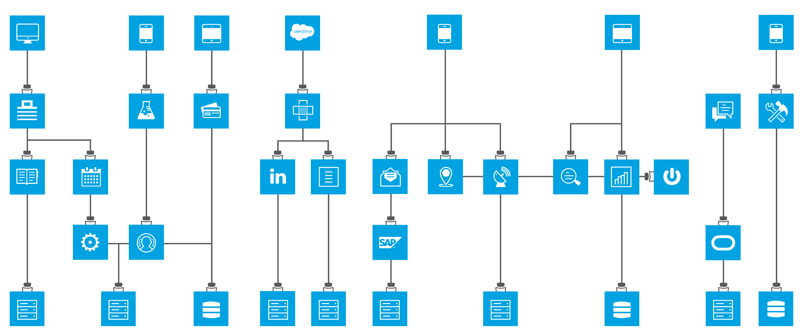
Overall possibilities with Mulesoft

Slide 16
Overall possibilities with Mulesoft…
I have worked on Mule ESB from last 4+ years but there was not a single moment where I was stucked at all. I have worked on many connectors few of them are:
Salesforce , HTTP, HTTPS, FTP,SFTP,JMS, Colibra, Slack, Qualtrics, Microsoft Sharepoit, Object Store, Workday , LDAP , Kafka , NetSuite , Oracle Siebel,DB , HL7 , IMAP , SMTP, Dropbox , DoubleClick , LinkedIn etc.

